Slide 1
WEATHER EFFECTS ON THE STOCK MARKET
Visswanath Venkataraman
Hyeoncheol Baik
Xing Wang

Slide 2
Introduction
Over the past decade many important factors have been identified which tends to affect the stock market.
Economic factors which affect stock performances are viz unemployment rate,GDP growth & CPI.
Some exogenous factors are viz personal problems, natural disasters tend to affect the investors mood & eventually their decision making process.
Among the exogenous factors, we explore the effect of weather on stock returns.
Psychological findings point out that investors are happier & more energetic on sunny days as compared to gloomy overcast days.

Slide 3
Data Collection
Datasets used in this project are viz weather & stock market data.
Weather data was obtained from National Environmental Satellite, Data, and Information Service (NESDIS) & LaGuardia airport in NY city which is closest to weather station near NYSE.
Stock market data was obtained from Yahoo finance website
Our focus is on S&P 500 & NASDAQ enlisted companies.

Slide 4
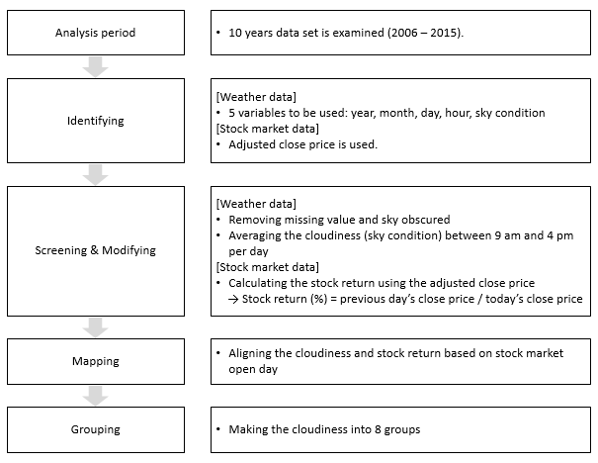
Data processing procedure

Slide 5
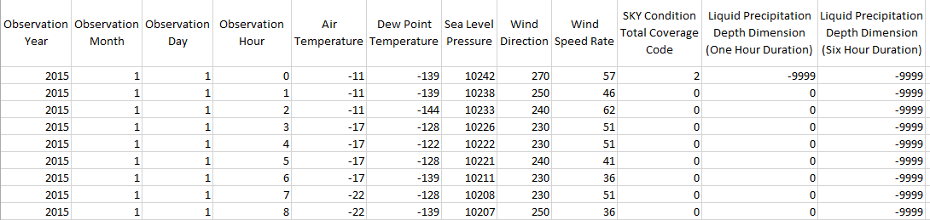
LaGuardia airport dataset
Of the 12 variables below, we focus on a selective 5 viz : Year,Month,Day,Hour & Sky condition (Cloudiness measure from 0 to 8)

Slide 6
Screening & modifying process
The screening and modifying process:
In this step we filter out the times when cloudiness information is hard to obtain.
We place focus on cloudiness measure from 9am – 4pm which is aligned with the stock market timing from 9:30 am – 4:30 pm.

Slide 7
Mapping procedure & platforms used
Finally we have the cloudiness data for all 365 days however stock market data is available for only 252 days (M-F).
The cloudiness on a measure of 0-7 with ‘0’ being sunny & ‘7’ being overcast is obtained for the 252 days against the corresponding stock returns.
Platforms used for data visualisation: Shiny & D3.

Slide 8
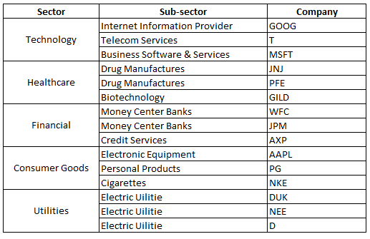
Sectors analysed

Slide 9
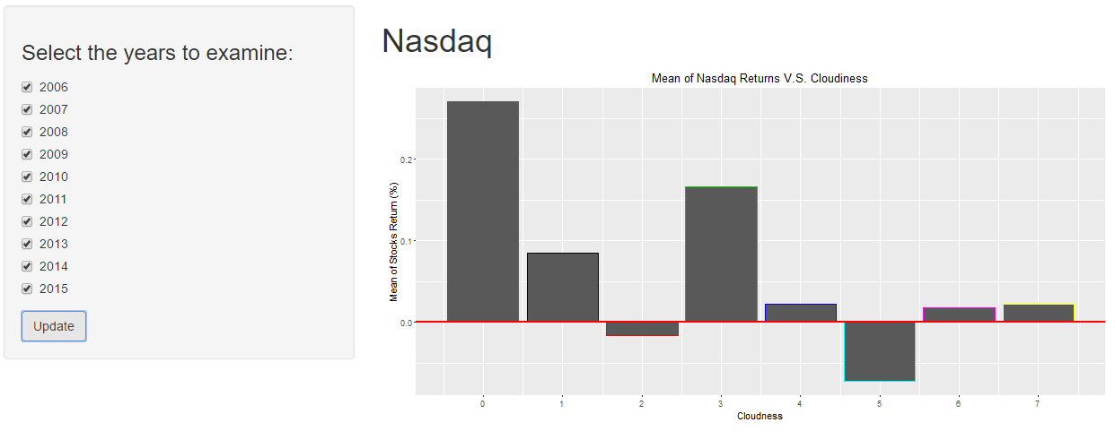
Analysis Results
How has the stock market behaved associated with varying cloudiness?
On sunny day (cloudiness: 0), the Nasdaq stock return has much higher performance rather than other days. We observe that sunny day’s stock return (0.27%) is over thirty-four times higher than the worst case of which cloudiness is 5, and over thirteen times higher than the cloudiest day. The overall figure also indicates that the stock return seems like follow a wave pattern

Slide 10
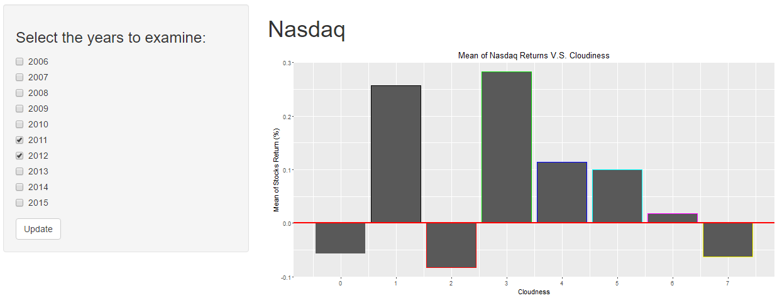
Analysis Results
It is noted from the above graph that the stock return has negative number in 2011 and 2012 while it has positive one on all other years.

Slide 11
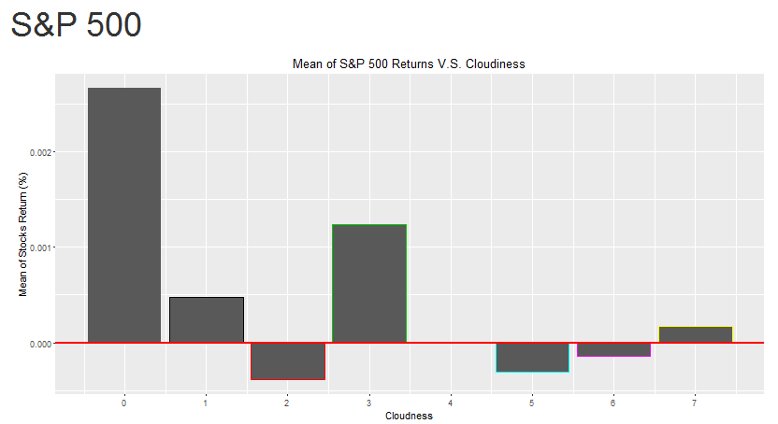
Analysis Results
Is there any difference between two stock market exchanges (Nasdaq and S&P 500) associated with varying cloudiness?
The S&P 500 shows quite similar tendency of Nasdaq as illustrated in Figure 0. On sunny day, investors receive much higher return (0.27%) that is over thirty-one times higher than the worst case of which cloudiness is 2, and over thirteen higher than the cloudiest day.

Slide 12
Analysis Results
For the Nasdaq, how has the stock return changed over years on some particular cloudiness conditions?
Findings from the graph above, we can see that recession affected the year 2008 very badly when the stock returns was -0.17%. Also post the recession, the market picked up quickly & has since then followed an up down trend. slow pace

Slide 13
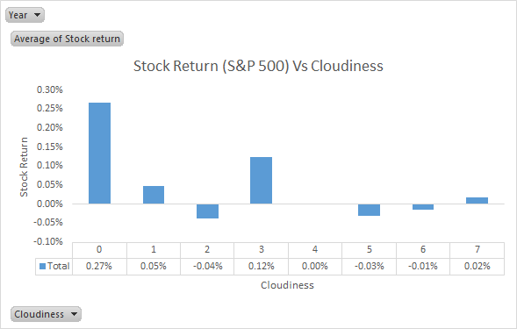
Analysis Results
For the S&P 500, how has the stock return changed over years on some particular cloudiness conditions?
Finding from graph for the S&P 500 is similar to NASDAQ. The maximum stock return of 0.25% during sunny days is more than 13 times higher than when the stock returns are the worst (-0.04% when cloudiness level is 2).

Slide 14
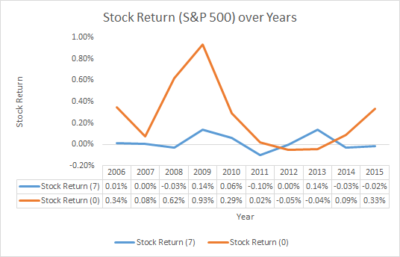
Analysis Results
Findings from the graph, very clearly show that during sunny days the year 2009 had a very good stock yield however it wasn’t that good in the year 2013. The stock returns when overcast has however maintained a constant trend despite some slight rises over the 10 year tenure.

Slide 15
Analysis Results
Which industry has been the most affected by weather (cloudiness)?
Financial stocks returns are more volatile at different cloudiness levels.
The average returns are highest when cloudiness=0 (i.e., during sunny days).
Reason might be that the weather affects the trading activity on Wall Street.
Trends are all similar for all categories, but vary much less for other kinds.

Slide 16

Thank You….
Questions ???

